Slide 1
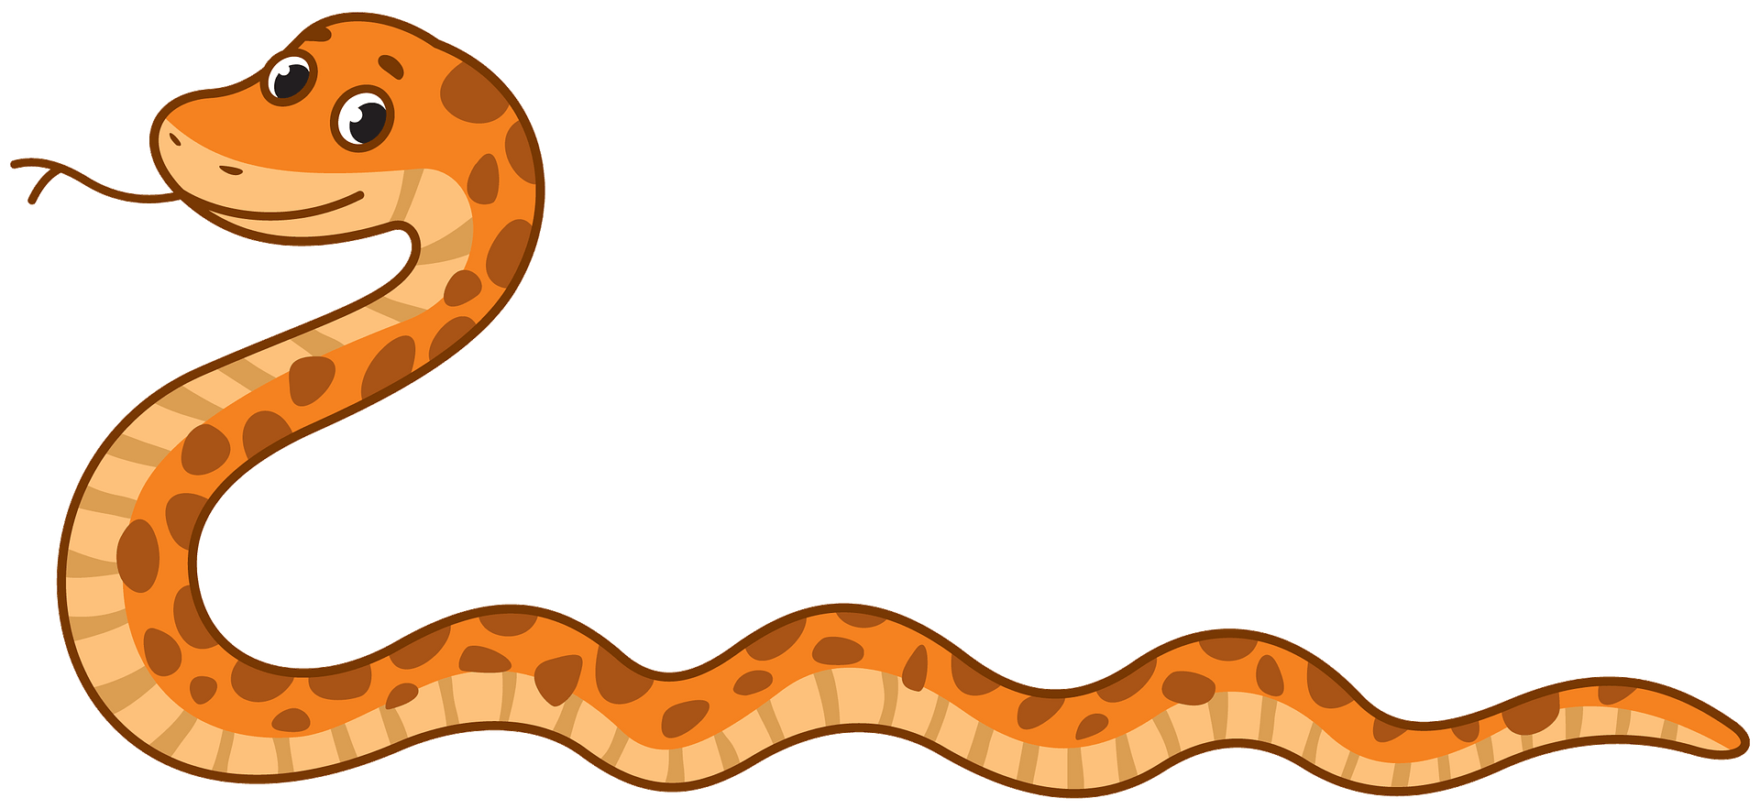
Animal movement – gibanje živali
TJA, 23. 11. 2020
UČITELJICA MINJA MLAKAR

Slide 2
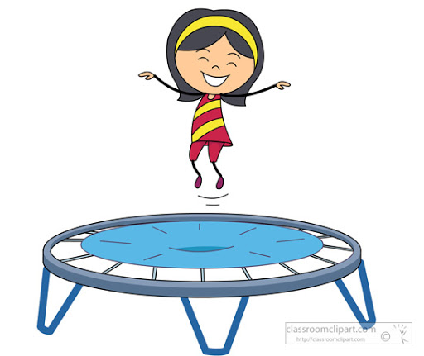

POSLUŠAJ IN PONOVI

Slide 3
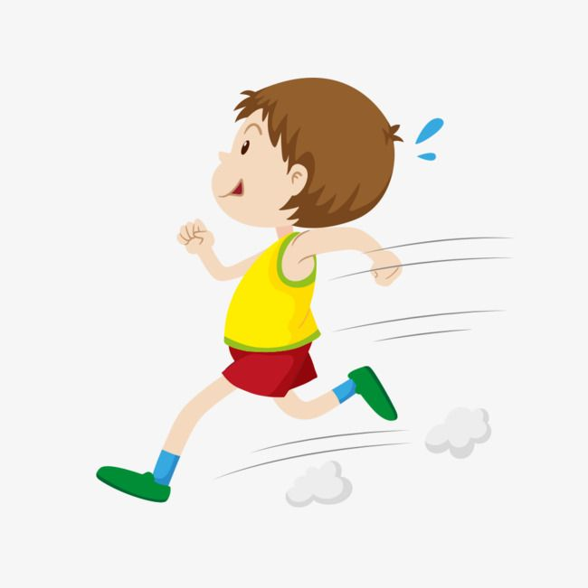

Slide 4
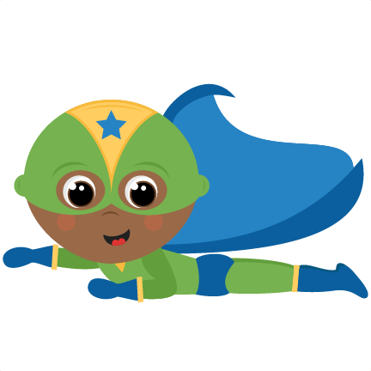

Slide 5
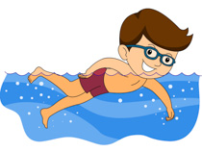

Slide 6
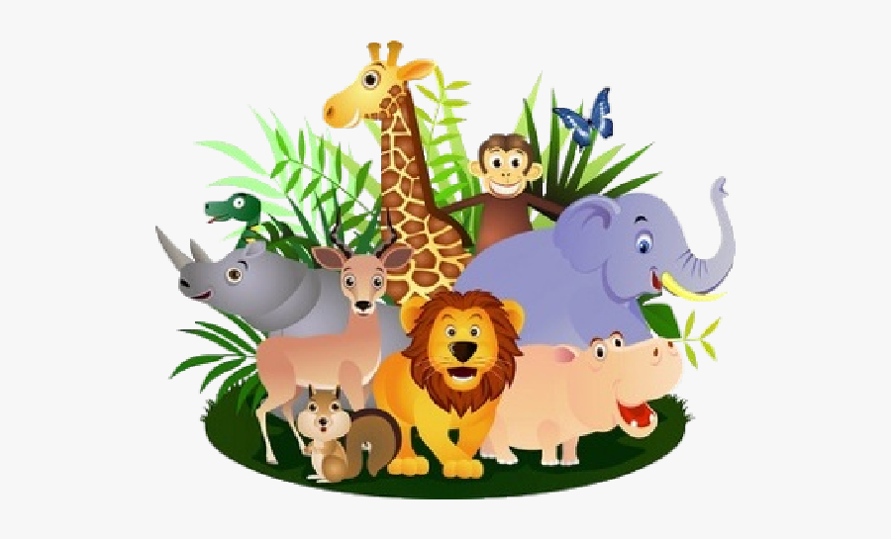
ODPRI POVEZAVO IN PONOVI ŽIVALI:
https://www.liveworksheets.com/worksheets/en/English_as_a_Second_Language_(ESL)/Animals/ANIMALS_uj1520lh

Slide 7
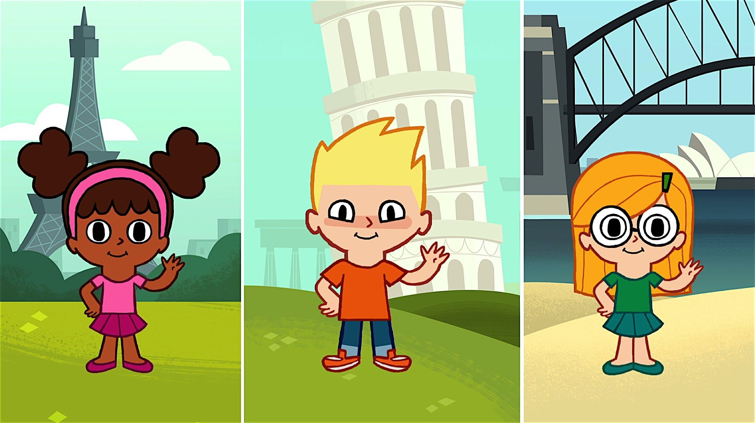
VSTANI, POKAŽI IN ZAPOJ ☺
https://www.youtube.com/watch?v=fN1Cyr0ZK9M – Hello, hello! Can you clap your hands?

Slide 8
POSLUŠAJ IN DOPOLNI POVED Z JUMP, RUN, FLY ALI SWIM.
I AM A MONKEY. I CAN _____________.

Slide 9
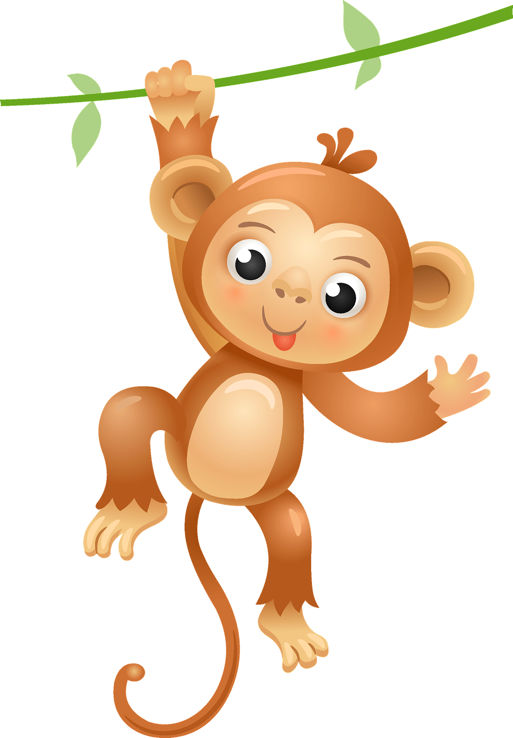
POSLUŠAJ IN DOPOLNI POVED S POIMENOVANJEM ŽIVALI IN JUMP, RUN, FLY ALI SWIM.
I AM A ____________.
I CAN _____________.

Slide 10
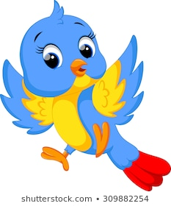
I AM A ____________.
I CAN _____________.

Slide 11

I AM A _______________.
I CAN _______________.

Slide 12
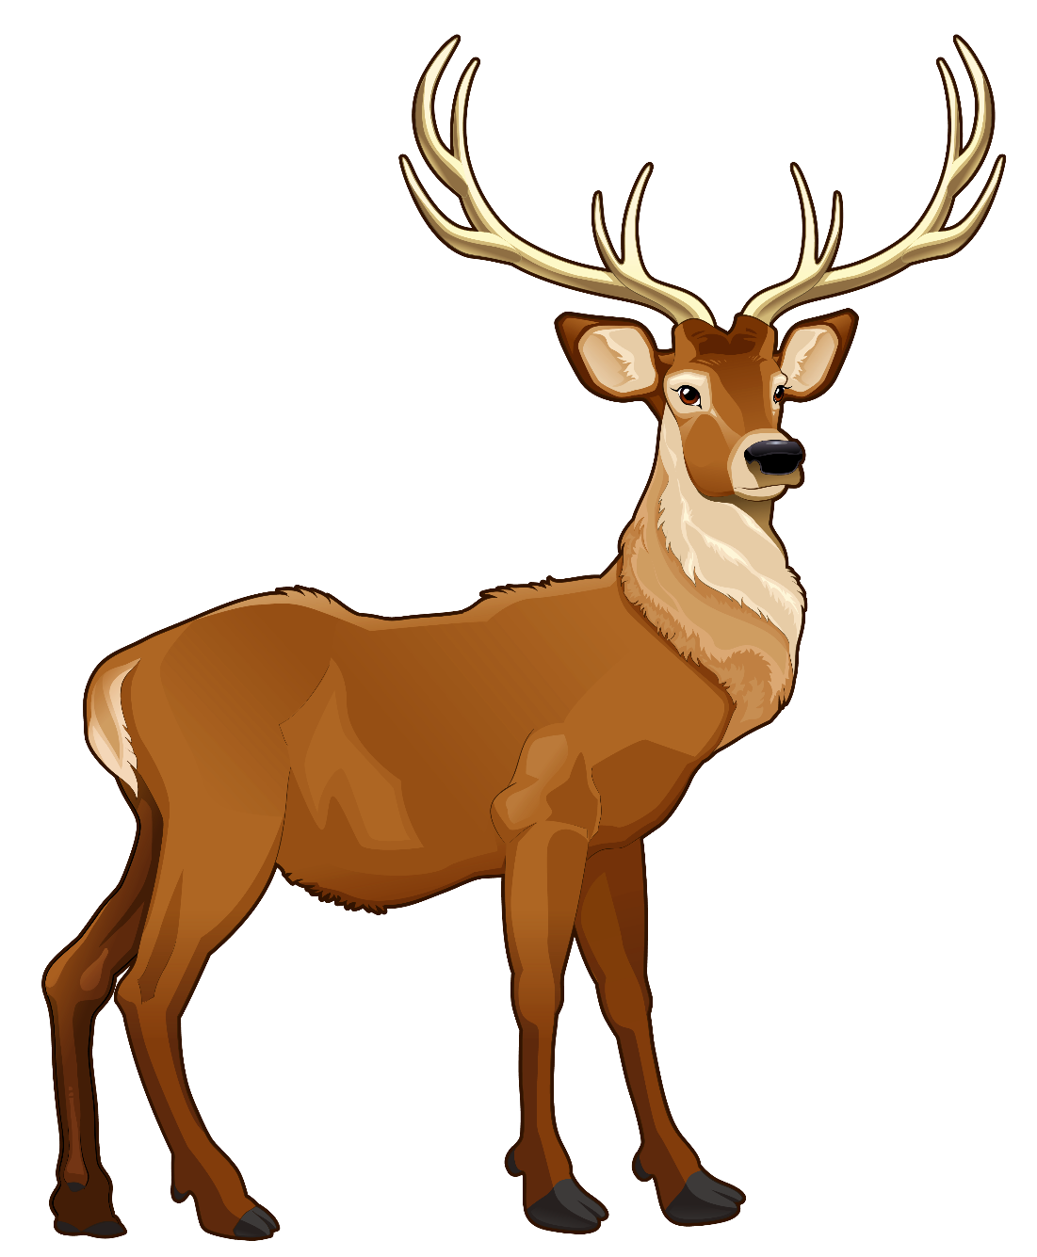
I AM A _____________ .
I CAN ______________.

Slide 13
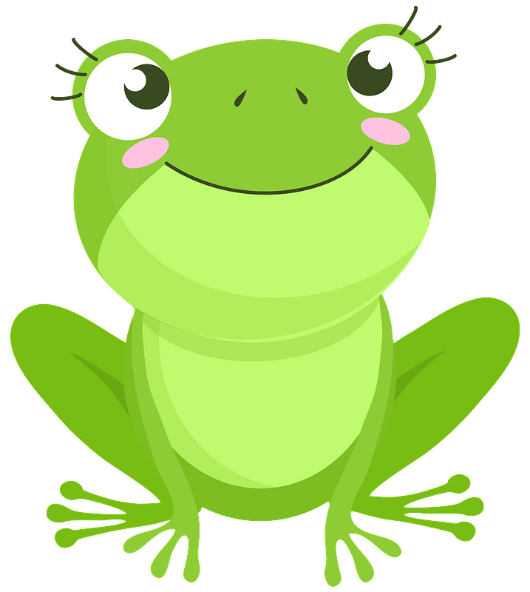
BI ZNAL SAM POVEDATI ZA TO ŽIVAL?
PREVERI TUKAJ.

